Slide 1
MATH
MULTIPLICATION
STRATEGIES

Slide 2
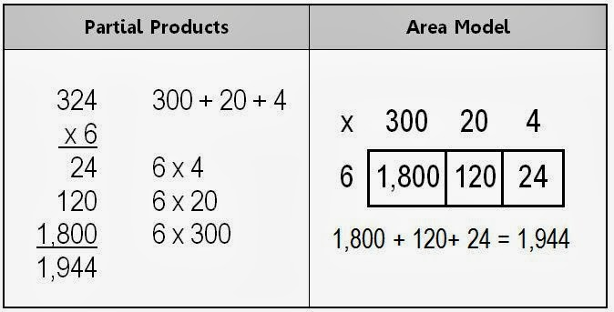
AREA AND PARTIAL PRODUCT MODELS

Slide 3
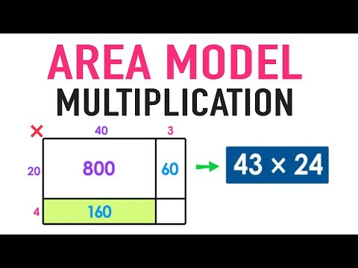
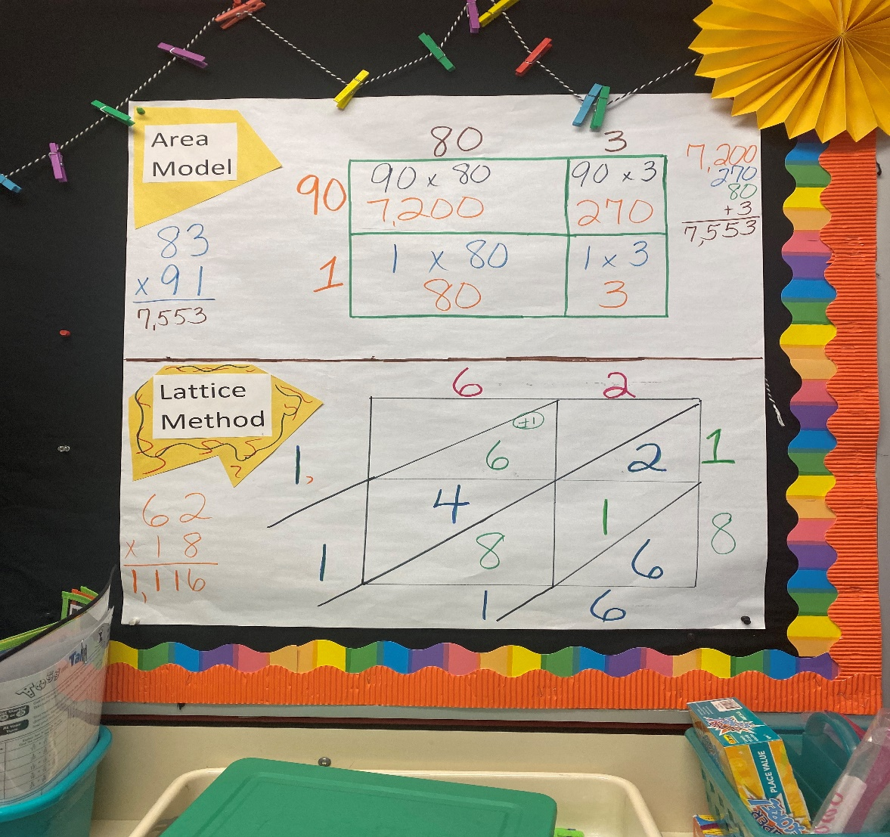
AREA & LATTICE WITH 2-DIGITS NUMBERS

Slide 4
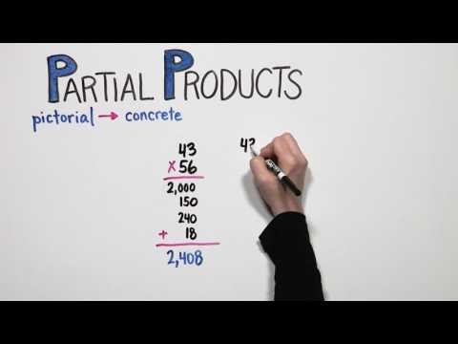
Partial Product Strategy

Slide 5
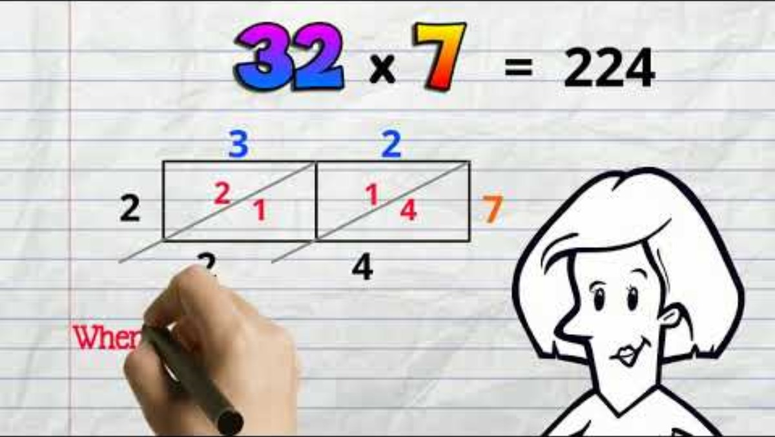
Lattice Strategy

Slide 6
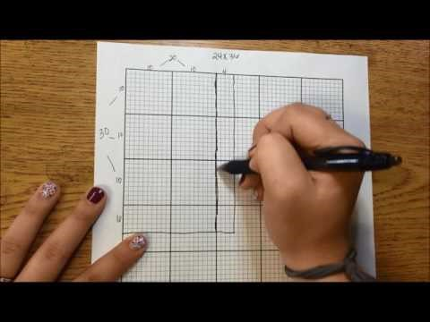
Area Multiplication using graph paper

